Slide 1


Locational Marginal Pricing
Time Series Modeling

Slide 2


Energy Grid & LMP
Nodes comprise energy grid (over 11k PJM)
Each node measures LMP i.e., the cost of making & delivering electricity in real time
Important - provides transparency & informs smart infrastructure investments

Slide 3
Problem
Can forecasting nodes’ LMP reveal nodes that are whose predictions yield greater errors?
Target nodes that are most in need of upgrading
Better informed wholesale market buyers & sellers can make superior decisions surrounding price

Slide 4
Dataset
3-months of data
467,208 rows/observations
216 unique nodes
Measurement every 5 minutes
19 features
Resampled by hour and mean

Slide 5
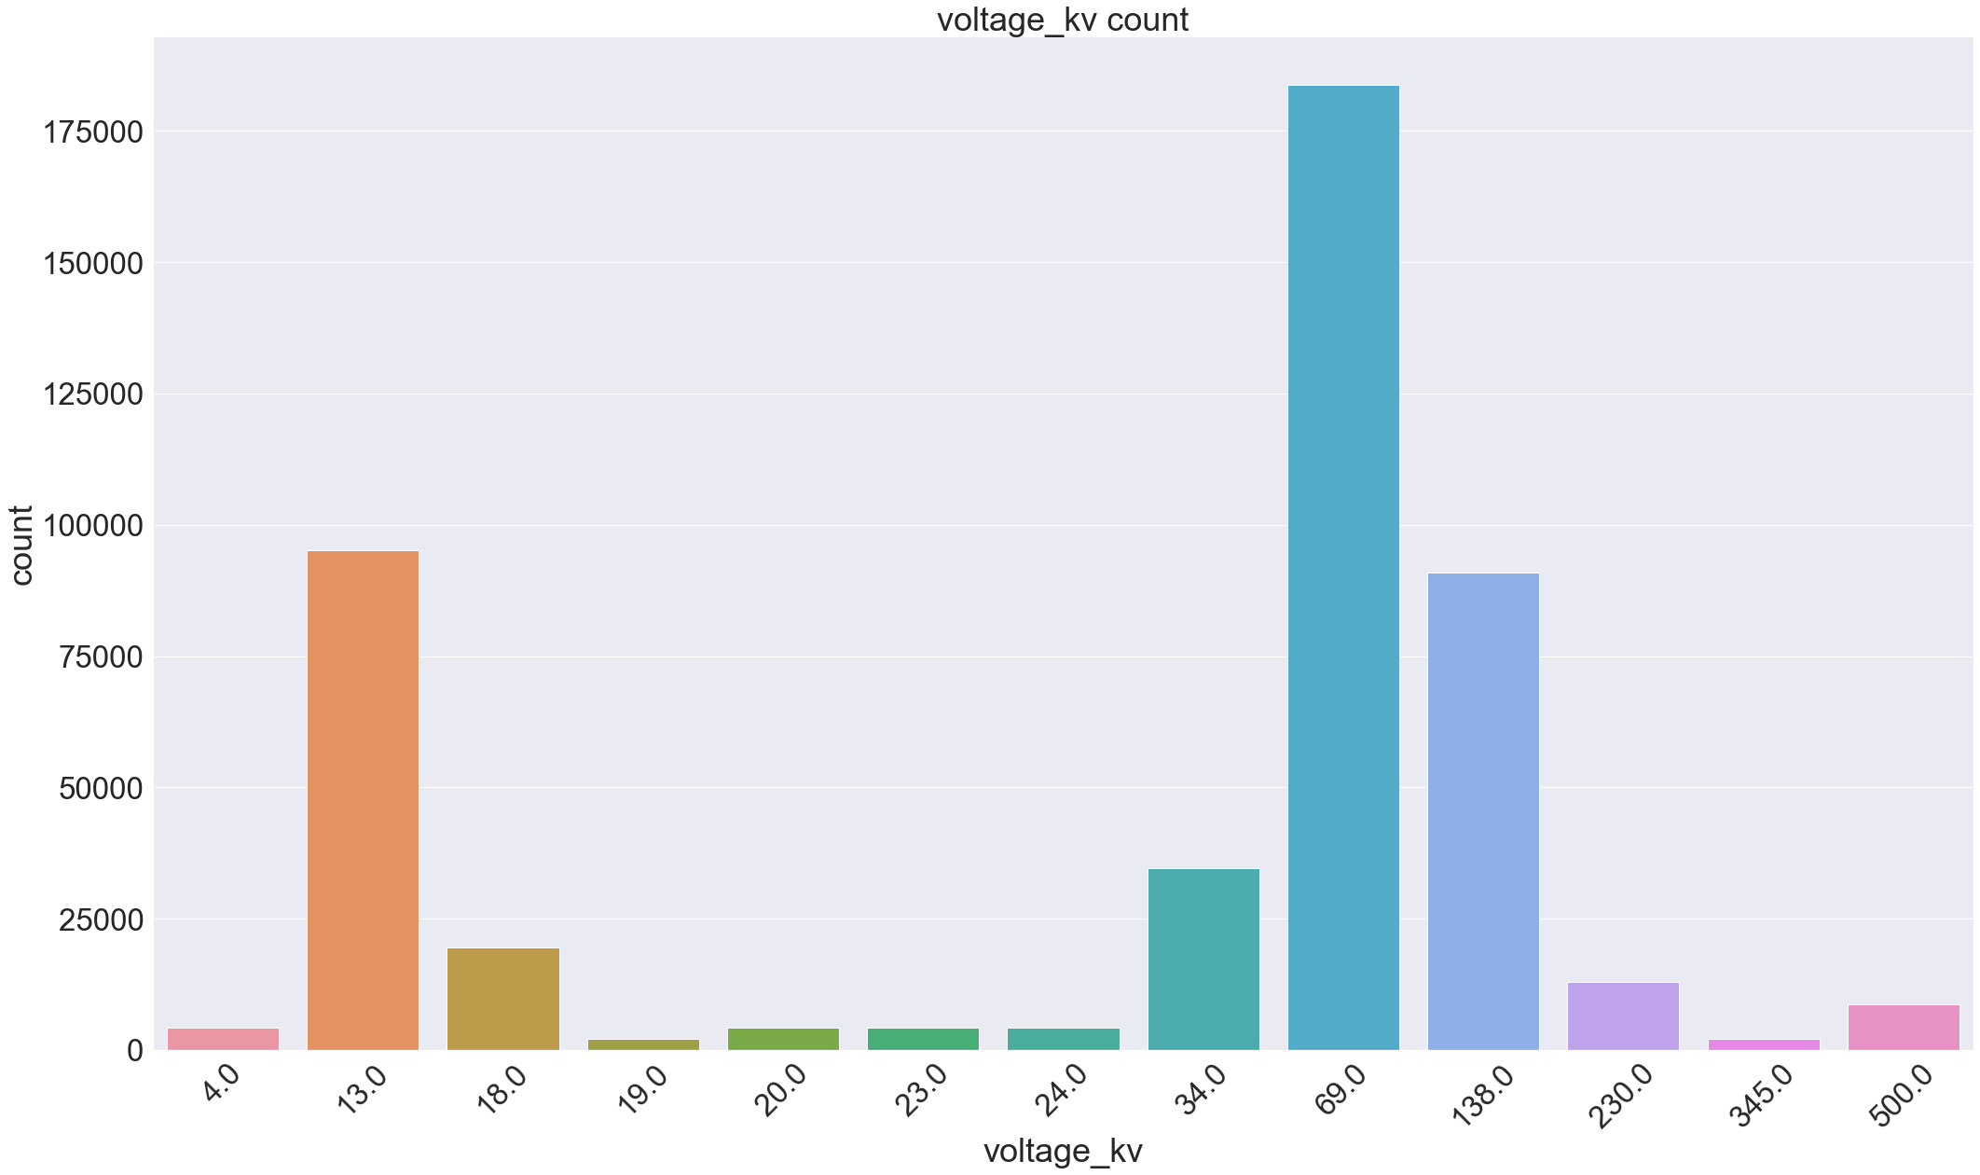
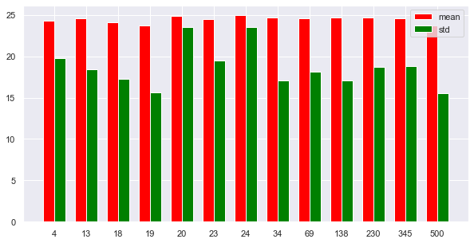
Data Analysis
Approximately 80% of nodes are of three voltages
Marked differences in LMP variability across voltages

Slide 6
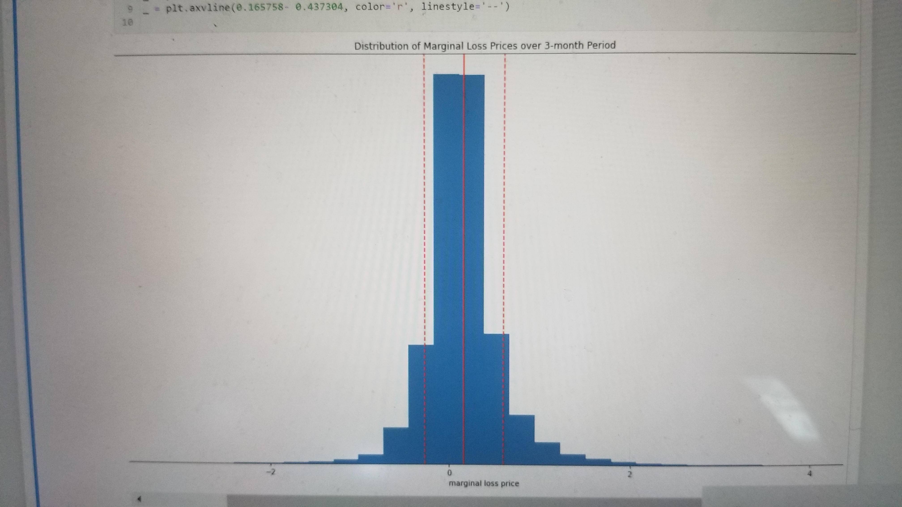
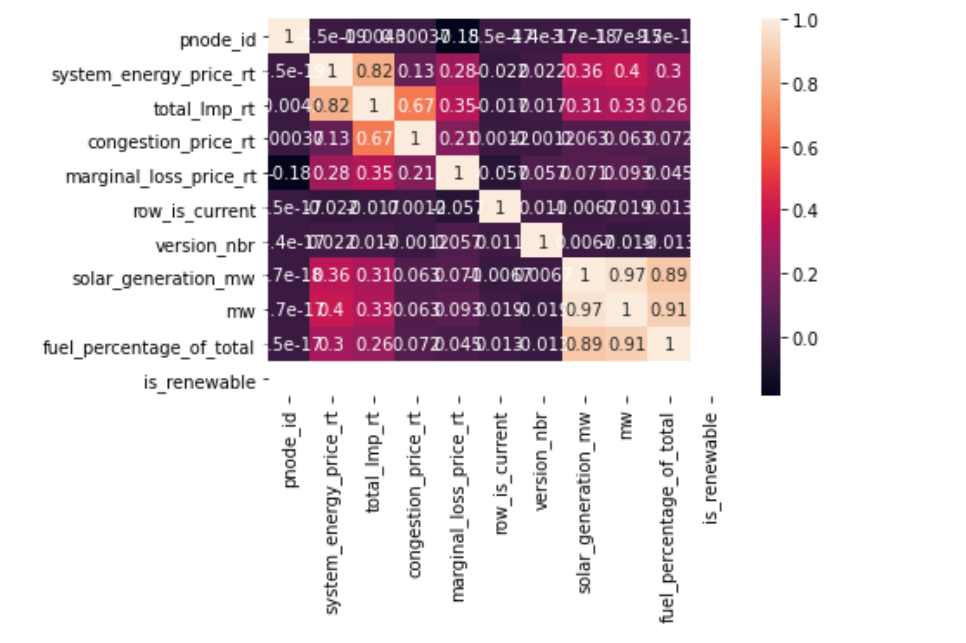
Data Analysis
LMPs Normally Distributed
LMP & Congestion price strongly correlated

Slide 7
Modeling
ARIMA
(4, 0, 2) RMSE=11.058
SARIMA
[(0, 0, 0), (2, 1, 0, 24), 'n’]] RMSE=14.119
Prophet
RMSE=14.625

